Slide 1
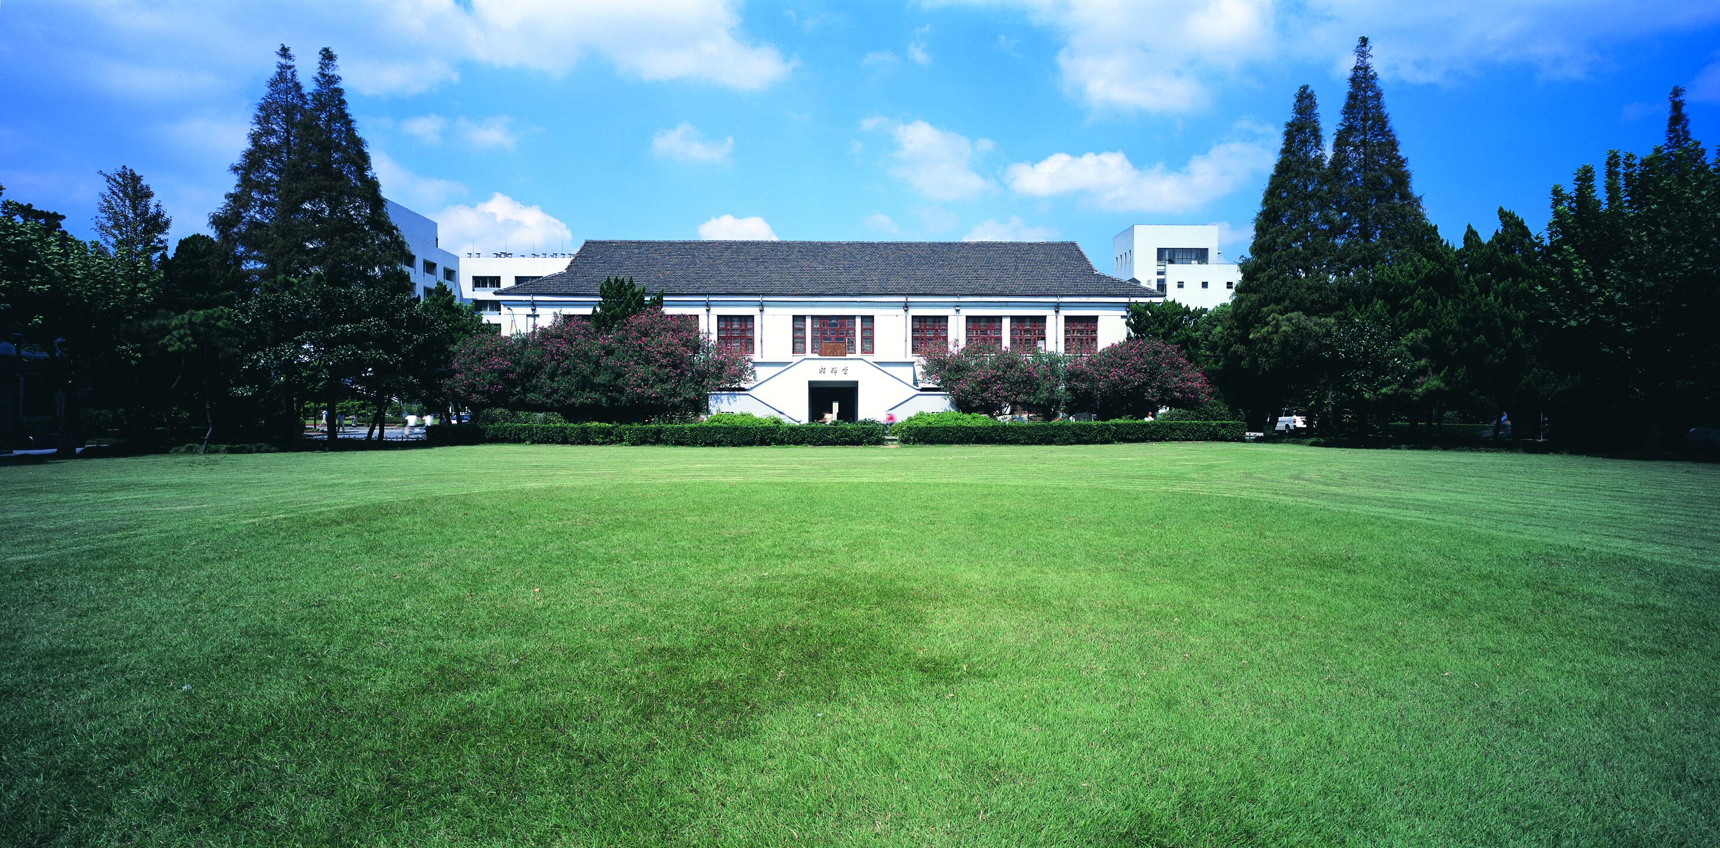
智能视频监控处理
Person Re-identification with Deep Similarity-Guided Graph Neural Network
CUHK-SenseTime Joint Lab, The Chinese University of Hong Kong
ECCV 2018
侯君临 18110240004
Notes:
利用深度相似性引导的图网络做行人重识别

Slide 2
Introduction
1

Slide 3

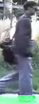
1. Introduction
1. Given an image or description of a person observed in one camera view.
2. Locate all other images of the same person from any other camera view.
1.1 Definition

Slide 4
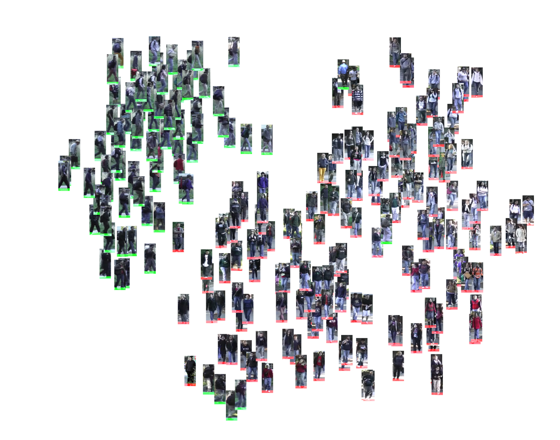
1. Introduction
1. Given an image or description of a person observed in one camera view.
2. Locate all other images of the same person from any other camera view.
1.1 Definition

Slide 5
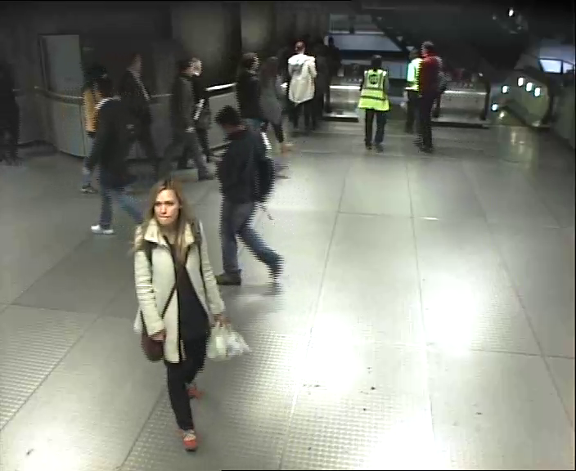
1. Introduction
Underpins visual automated surveillance tasks:
Tracking between cameras
Locate specific suspects
Person counting
Human traffic analysis
Incident / Intrusion detection
?
?
1.2 Application

Slide 6
1. Introduction
Underpins visual automated surveillance tasks:
Tracking between cameras
Locate specific suspects
Person counting
Human traffic analysis
Incident / Intrusion detection
1.2 Application

Slide 7
1. Introduction
Underpins visual automated surveillance tasks:
Tracking between cameras
Locate specific suspects
Person counting
Human traffic analysis
Incident / Intrusion detection
13
1.2 Application

Slide 8
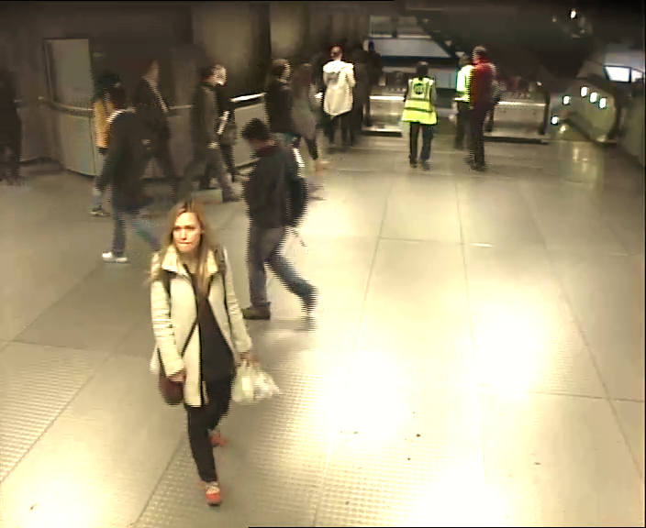
1. Introduction
Underpins visual automated surveillance tasks:
Tracking between cameras
Locate specific suspects
Person counting
Human traffic analysis
Incident / Intrusion detection
1.2 Application

Slide 9
1. Introduction
Underpins visual automated surveillance tasks:
Tracking between cameras
Locate specific suspects
Person counting
Human traffic analysis
Incident / Intrusion detection
1.2 Application

Slide 10
Method
2

Slide 11
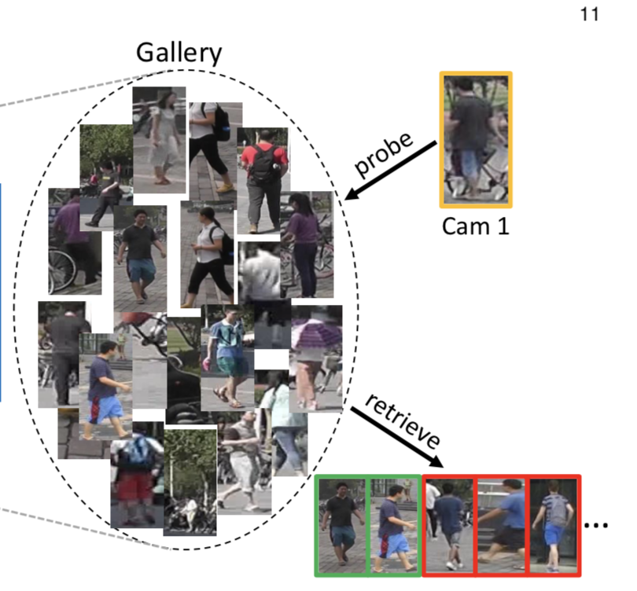
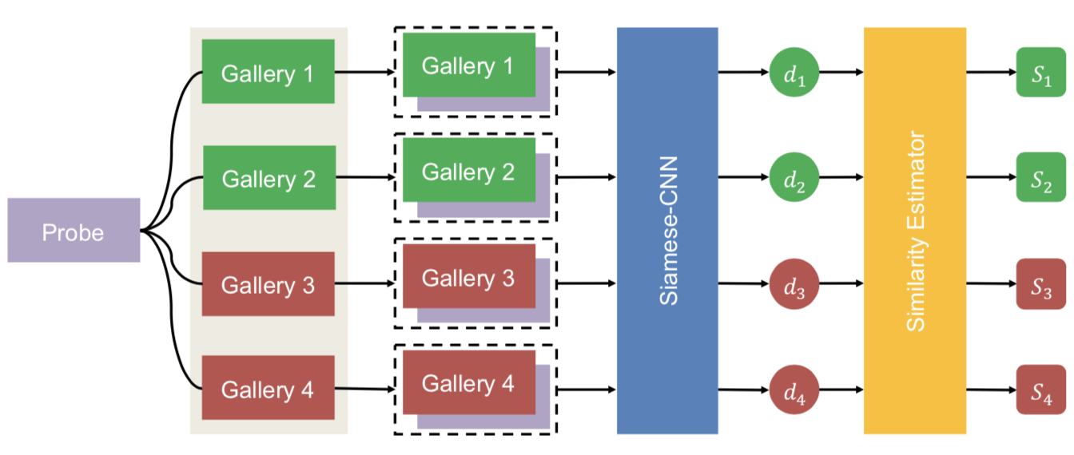
2. Method
Probe
Feature Extraction
Similarity Estimator
Gallery
2.1 Basic Person Re-id

Slide 12
2. Method
Hard positive pair
Easy positive pair
Gallery i
Probe
Gallery j
Probe
Gallery i
Gallery j
2.1 Basic Person Re-id

Slide 13
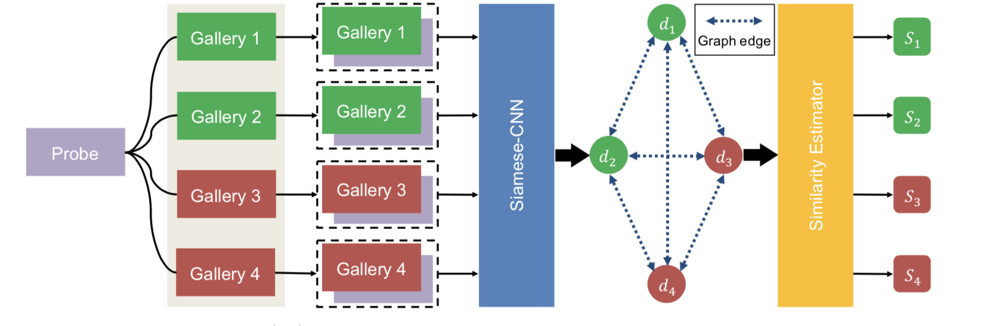
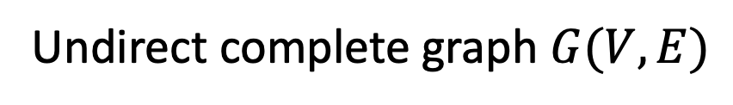
2. Method
Undirect complete graph $G(V,E)$
2.2 Graph formulation & Node features

Slide 14
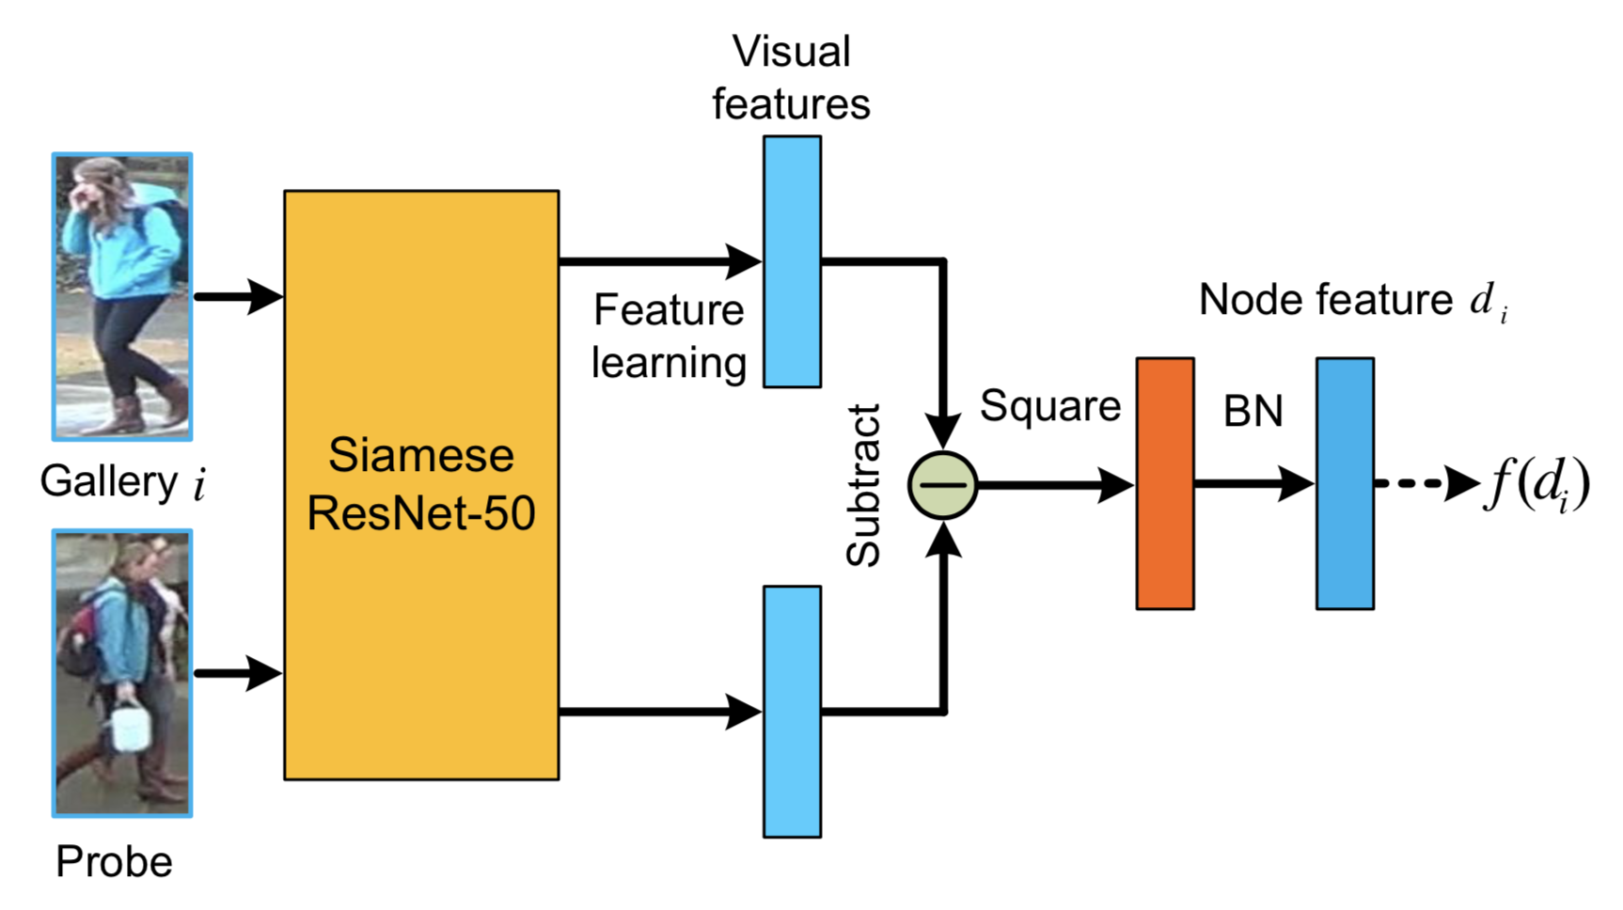
2. Method
Siamese-CNN
Siamese Network
Loss
Network1
Weights
Network2
Input 1
Input 2
2.3 Similarity-Guided GNN

Slide 15
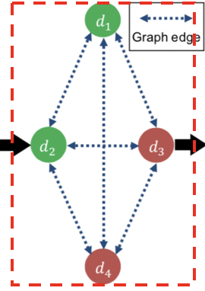
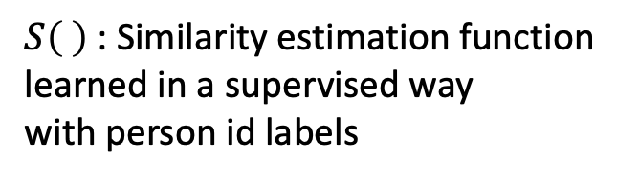
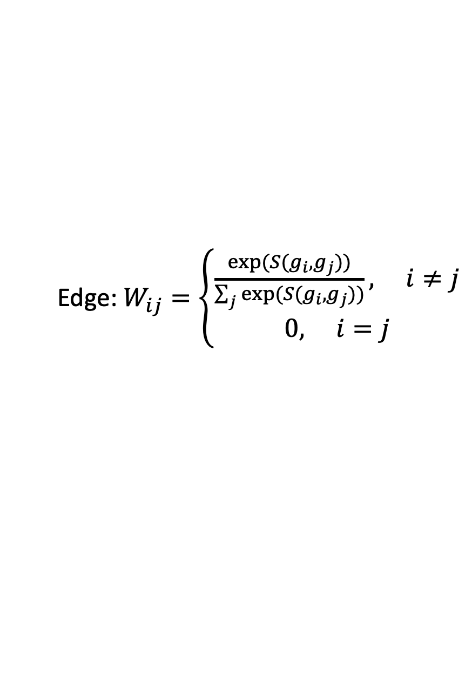
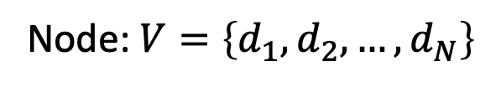
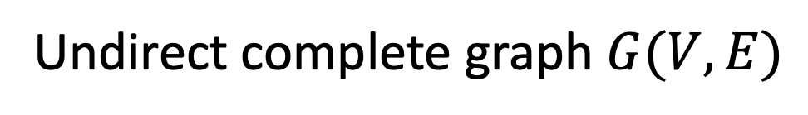
2. Method
Feature Fusion
Undirect complete graph $G(V,E)$
$S\left( \right)$: Similarity estimation function
learned in a supervised way
with person id labels
Node: $V=\left\{d_{1},d_{2},…,d_{N}\right\}$
Edge: $W_{ij}=\left\{\begin{aligned}\frac{\exp{(S(g_{i},g_{j}))}}{\sum_{j}{\exp{(S(g_{i},g_{j}))}}}, i≠j \\ 0, i=j\end{aligned}\right.$
Gallery j
2.3 Similarity-Guided GNN

Slide 16
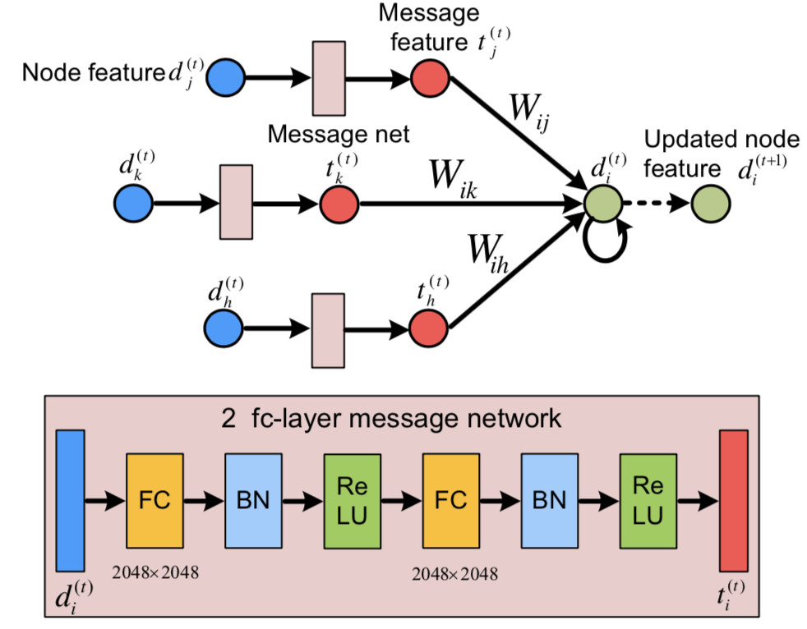
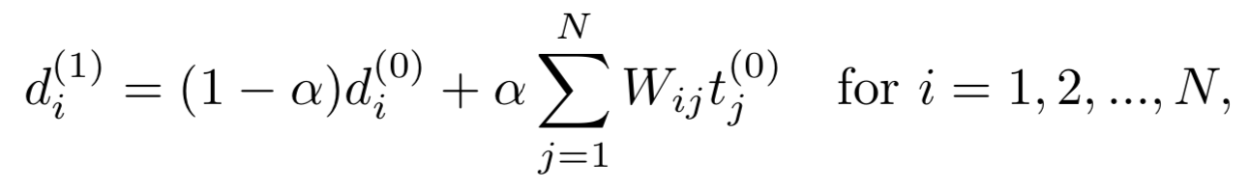
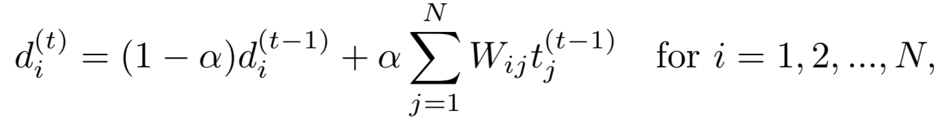
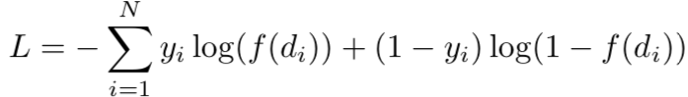
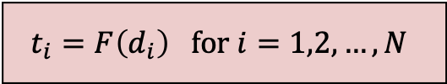
2. Method
$$t_{i}=F\left(d_{i}\right) for i=1,2,…,N$$
Loss
2.3 Similarity-Guided GNN

Slide 17
Experiments
3

Slide 18
3. Experiments
Datasets
Datasets | Team | Year | Img_num | Id_num | Camera_num | Place
DukeMTMC | UTS | 2017 | 36,411 | 1,812 | 8 | Campus
Market-1501 | Tsinghua | 2015 | 32,668 | 1,501 | 6 | Campus
CUHK03 | CUHK | 2014 | 28,192 | 1,467 | 10 | Campus
Evaluation Metrics
mAP
CMC
Top-1
CMC
Top-5
CMC
Top-10
3.1 Datasets and Evaluation Metrics

Slide 19
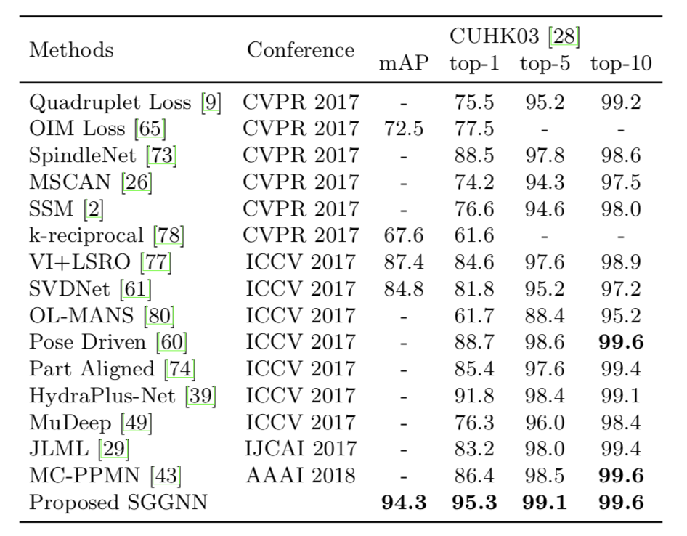
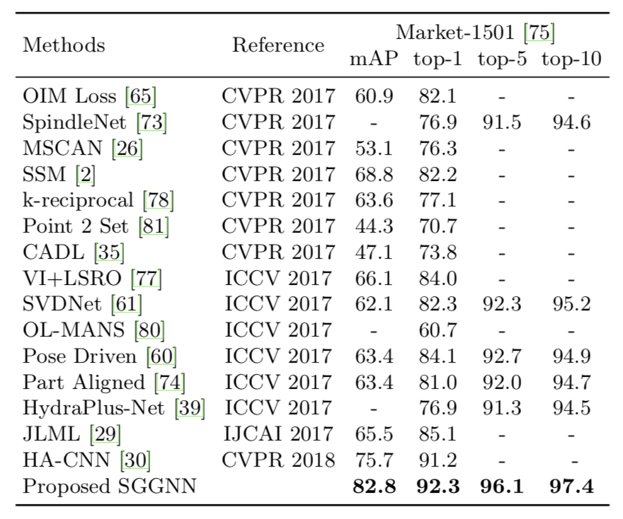
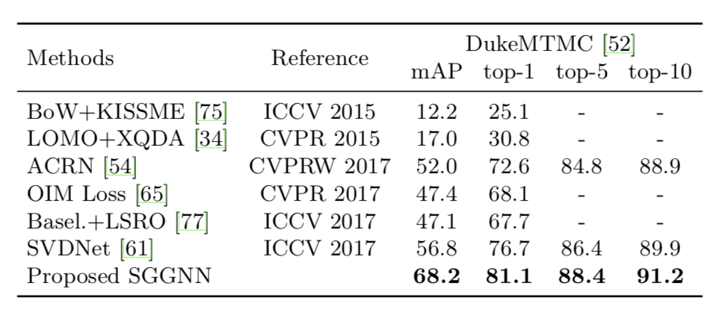
3. Experiments
3.2 Comparison with State-of-the-art Methods

Slide 20
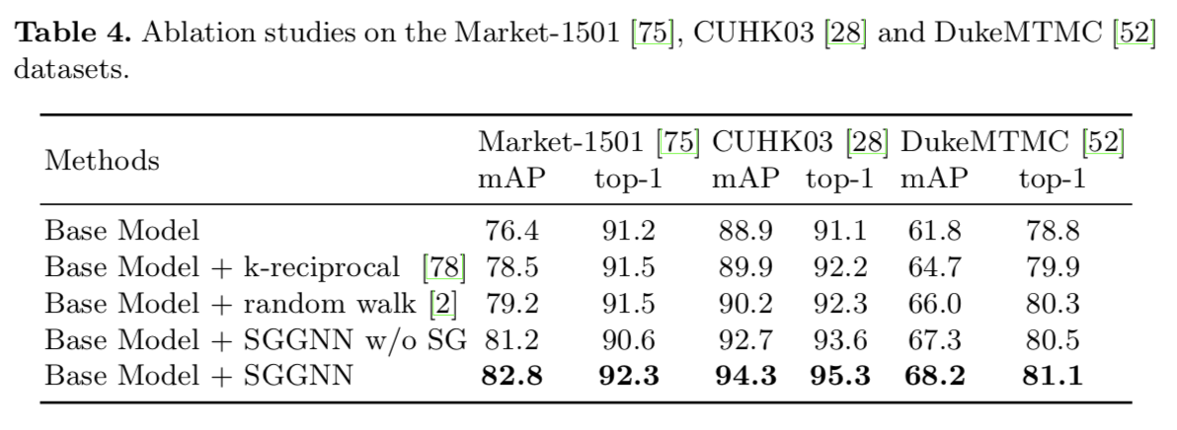
3. Experiments
3.3 Ablation Study

Slide 21
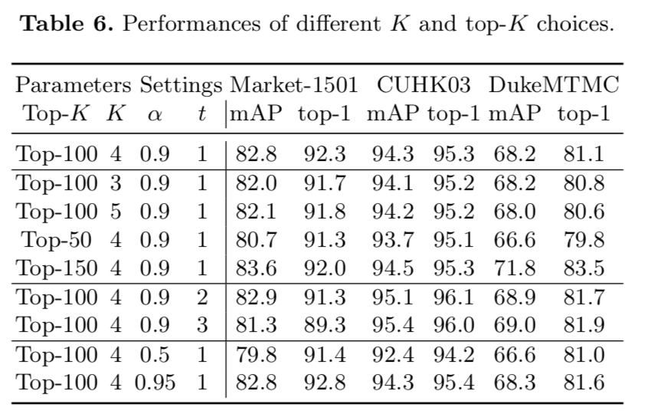
3. Experiments
3.4 Sensitivity Analysis

Slide 22
Conclusion
4

Slide 23
4. Conclusion
Similarity-Guided Graph Neural Network
Incorporate the rich gallery-gallery similarity information into training process of person re-id.
Utilize all valuable labels to ensure the weighted deep message fusion is more effective.
Discuss
1.
2.
Notes:
考虑gallery内的关系，相似度平滑的思想，强行套入GNN，表现在更新次数上，图网络动态更新，而效果反而变差了
图网络中的信息传递机制，从特征到信息的编码层用的是两个全连接层？节点的更新式子用的是最简单的线性加权，在其他的图网络里更新节点的方法有很多，包括用指数 对数 或者直接过一个神经网络来更新。
整个思路比较有创新，在理论方面还有值得深究的地方

